Slide 1
Diving Deeper into
Text Analysis in R
Alison Blaine, Erica Hayes & Markus Wust
NCSU Libraries
workspace: go.ncsu.edu/textr
slides: go.ncsu.edu/textrslides
Notes:
Alison through slide 7

Slide 2

Welcome!
Notes:
A
Welcome and thanks everyone for coming to our course. This course will provide a broad overview of text analysis in R. We’re librarians at NCSU Libraries and we hope to help you become more comfortable understanding ways that R can be used for text harvesting and analysis purposes. We use R for data manipulation, cleaning and visualization, but we’re not experts, so we’re learning along with you. If we don’t know the answer, we’ll help you find it (we’re librarians and that’s what we do)

Slide 3
Learning environment
Questions are welcomed
Requests to repeat/re-explain are
welcomed
Collaborators in learning - help
your neighbor if you can
We get imposter syndrome too
Notes:
A

Slide 4
Goals

Slide 5
Learn & implement some R functions for preprocessing text data
Notes:
A

Slide 6
Learn and implement some text analysis techniques using R
Notes:
A

Slide 7
Know how to seek help & resources in the future
Notes:
A

Slide 8

Notes:
Markus through slide 14

Slide 9
Text Analysis

Slide 10
Train computers to find similarities between texts, extract themes, and analyze expressed sentiments
Notes:
turn text into data for analysis, via application of natural language processing (NLP) and analytical methods" (Wikipedia)
Unlike data retrieved through APIs, textual data is usually not structured in a way that computers can "understand"
By using text analysis techniques, you can train computers to find similarities between texts, extract themes, and analyze expressed sentiments

Slide 11


Reading: Human - Machine

Slide 12
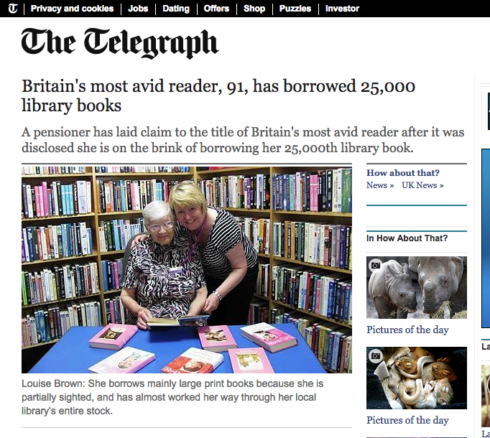
Slow
Limited memory
Limited factual background knowledge
Limited linguistic knowledge
Can understand "meaning"
Understand linguistic nuances and tone (e.g., sarcasm), allusions, emotions, etc.
Human Reader: Con - Pro

Slide 13

So far no actual comprehension
Usually no deeper understanding
No understanding of linguistic nuances, emotions, etc.
Fast
(Almost) unlimited memory
(Almost) instant access to supplementary information
Machine Reader: Con - Pro

Slide 14
Computerized text analysis can help you get an overview of large text corpora (from tweets to novels)
Indicate general trends
Extract data
On the other hand:
For a more in-depth analysis of a text, you still have to read it yourself
Text analysis less suited for poetic language
Text Analysis: What Is It Good For?

Slide 15

R for Text Analysis
Notes:
Erica through 21

Slide 16
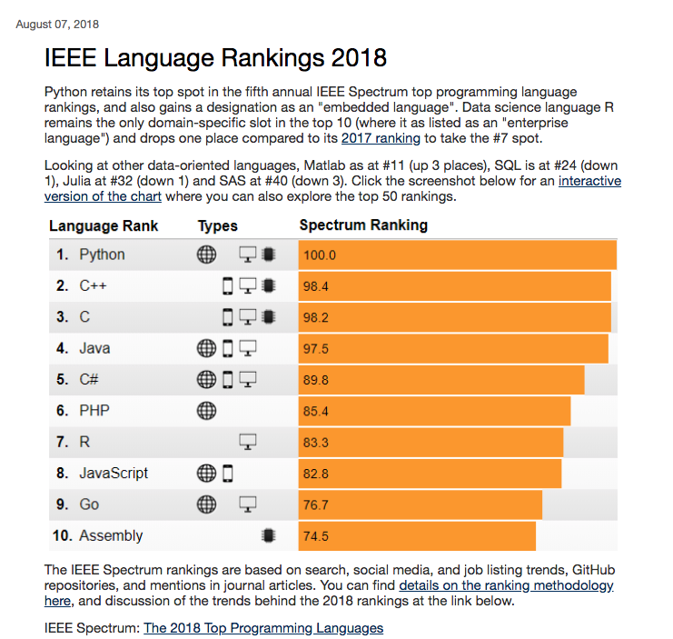

Popularity of R
source
Notes:
Source: https://blog.revolutionanalytics.com/popularity/
R was developed as an open-source alternative to expensive statistical analysis software platforms and has since become a leading tool for data scientists and statistical computing. However, R also can be used for text harvesting, preprocessing, & analysis.
Open-source statistical analysis & graphing language
Widely used in academia due to strength in creating publication-quality graphics
Robust user community and over 15000 registered packages
Moved beyond being just useful for statistics: data manipulation, cleaning, modeling, text mining, data harvesting, and natural language processing

Slide 17

Why is R so popular?
Versatility
Over 16,000 Packages
RStudio
tidyverse
Notes:
R has become so popular because it can be used for virtually any task working with data, including collecting, cleaning, analyzing & presenting the data.

Slide 18
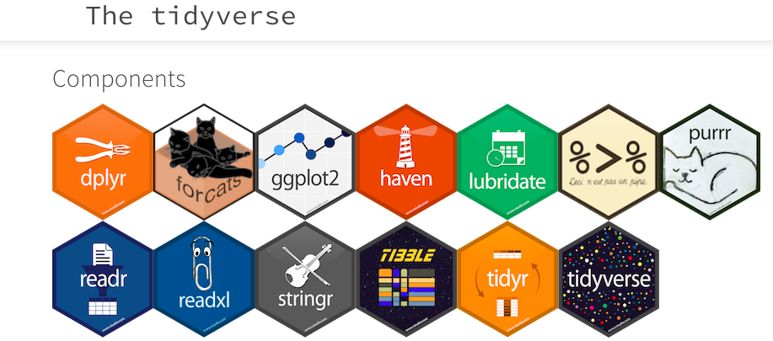
tm

Slide 19
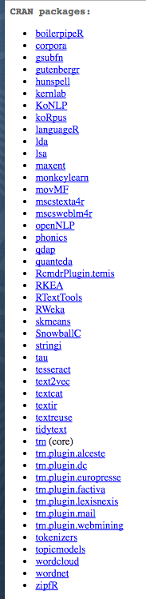
R Packages for Text Analysis
There are more than this -- see link!
https://cran.r-project.org/web/views/
NaturalLanguageProcessing.html
Notes:
There are well over 15,000 R packages registered currently. Here are the packages created for the purpose of text analysis. The most popular packages include tm, openNLP, and quanteda. Doing text analysis work, you’ll likely also going to use additional packages for data manipulation, cleaning, etc.
Indeed.com job ads, Feb 2017; Credit: Robert A. Muenchen;

Slide 20
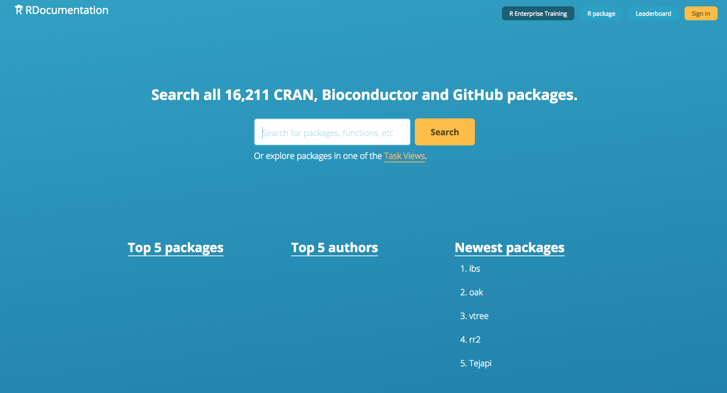

Slide 21
RStudio: a graphical user interface for R
available as a desktop application or as an online application

Slide 22
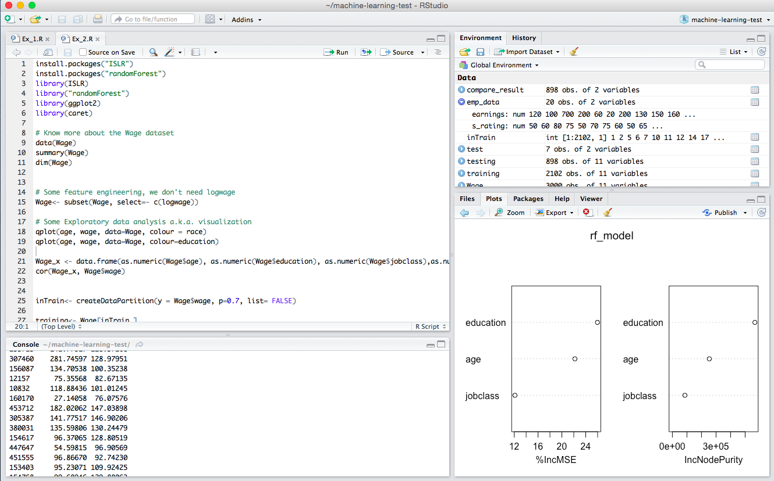
session info
script
plots, help,
file menu
output
Notes:
Here’s the RStudio interface. It’s divided into 4 windows where you can write script, view output, see session info, and see plots/help docs/file tree

Slide 23
RStudio Cloud: a web-based version of R Studio
same features, but also sharing options
Notes:
Alison 22 through 41

Slide 24
RStudio Cloud login
go.ncsu.edu/textr

Slide 25
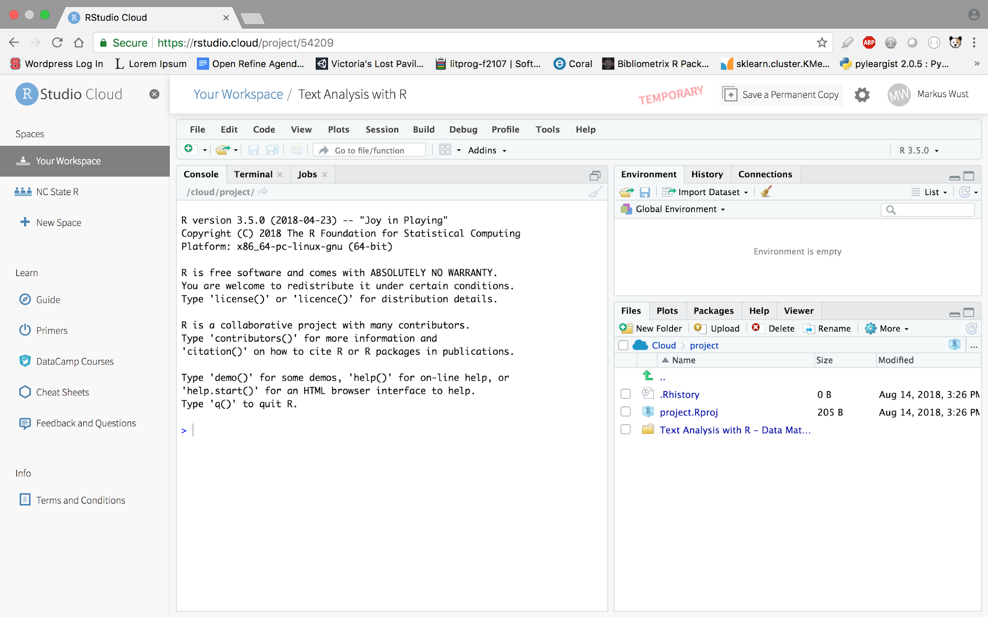
Notes:
Here’s the RStudio interface. It’s divided into 4 windows where you can write script, view output, see session info, and see plots/help docs/file tree

Slide 26

Relaxing
Dog
Picture

Slide 27
Preprocessing: Preparing Text for Analysis

Slide 28
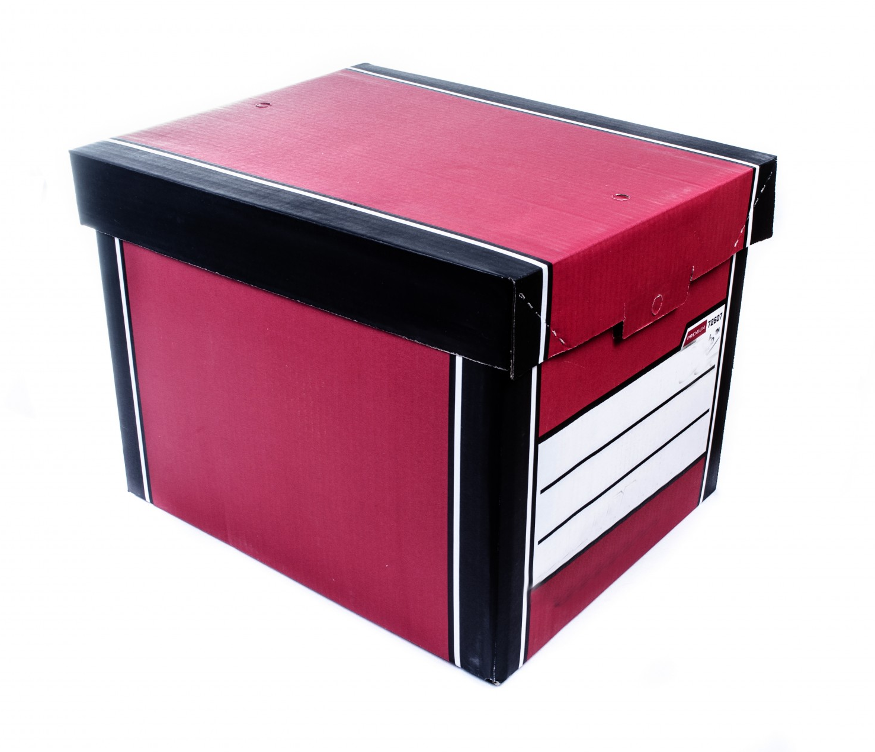

Step 1:
Create a corpus from your raw text file(s)

Slide 29
Corpus Object in R
Corpus is a data structure in R that represents a collection of documents that you import into R or access using an API.
tm package
SimpleCorpus
VCorpus
PCorpus

Slide 30
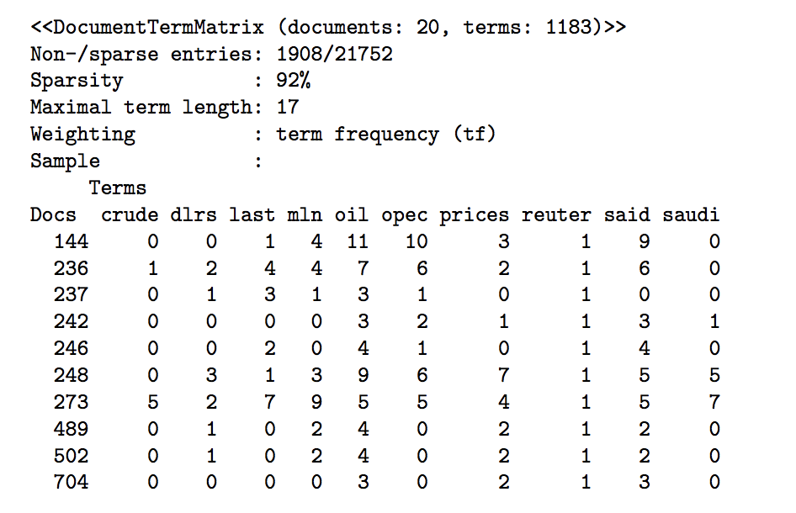
Why Create a Corpus?
Creating a corpus object gives you access to text mining and analysis functions from various text analysis R packages: tm, quanteda, openNLP, topicmodels, etc. From a corpus object you can:
data cleaning and transforming
filtering
document-term-matrix OR
term-document-matrix

Slide 31
Step 2:
Clean the corpus

Slide 32
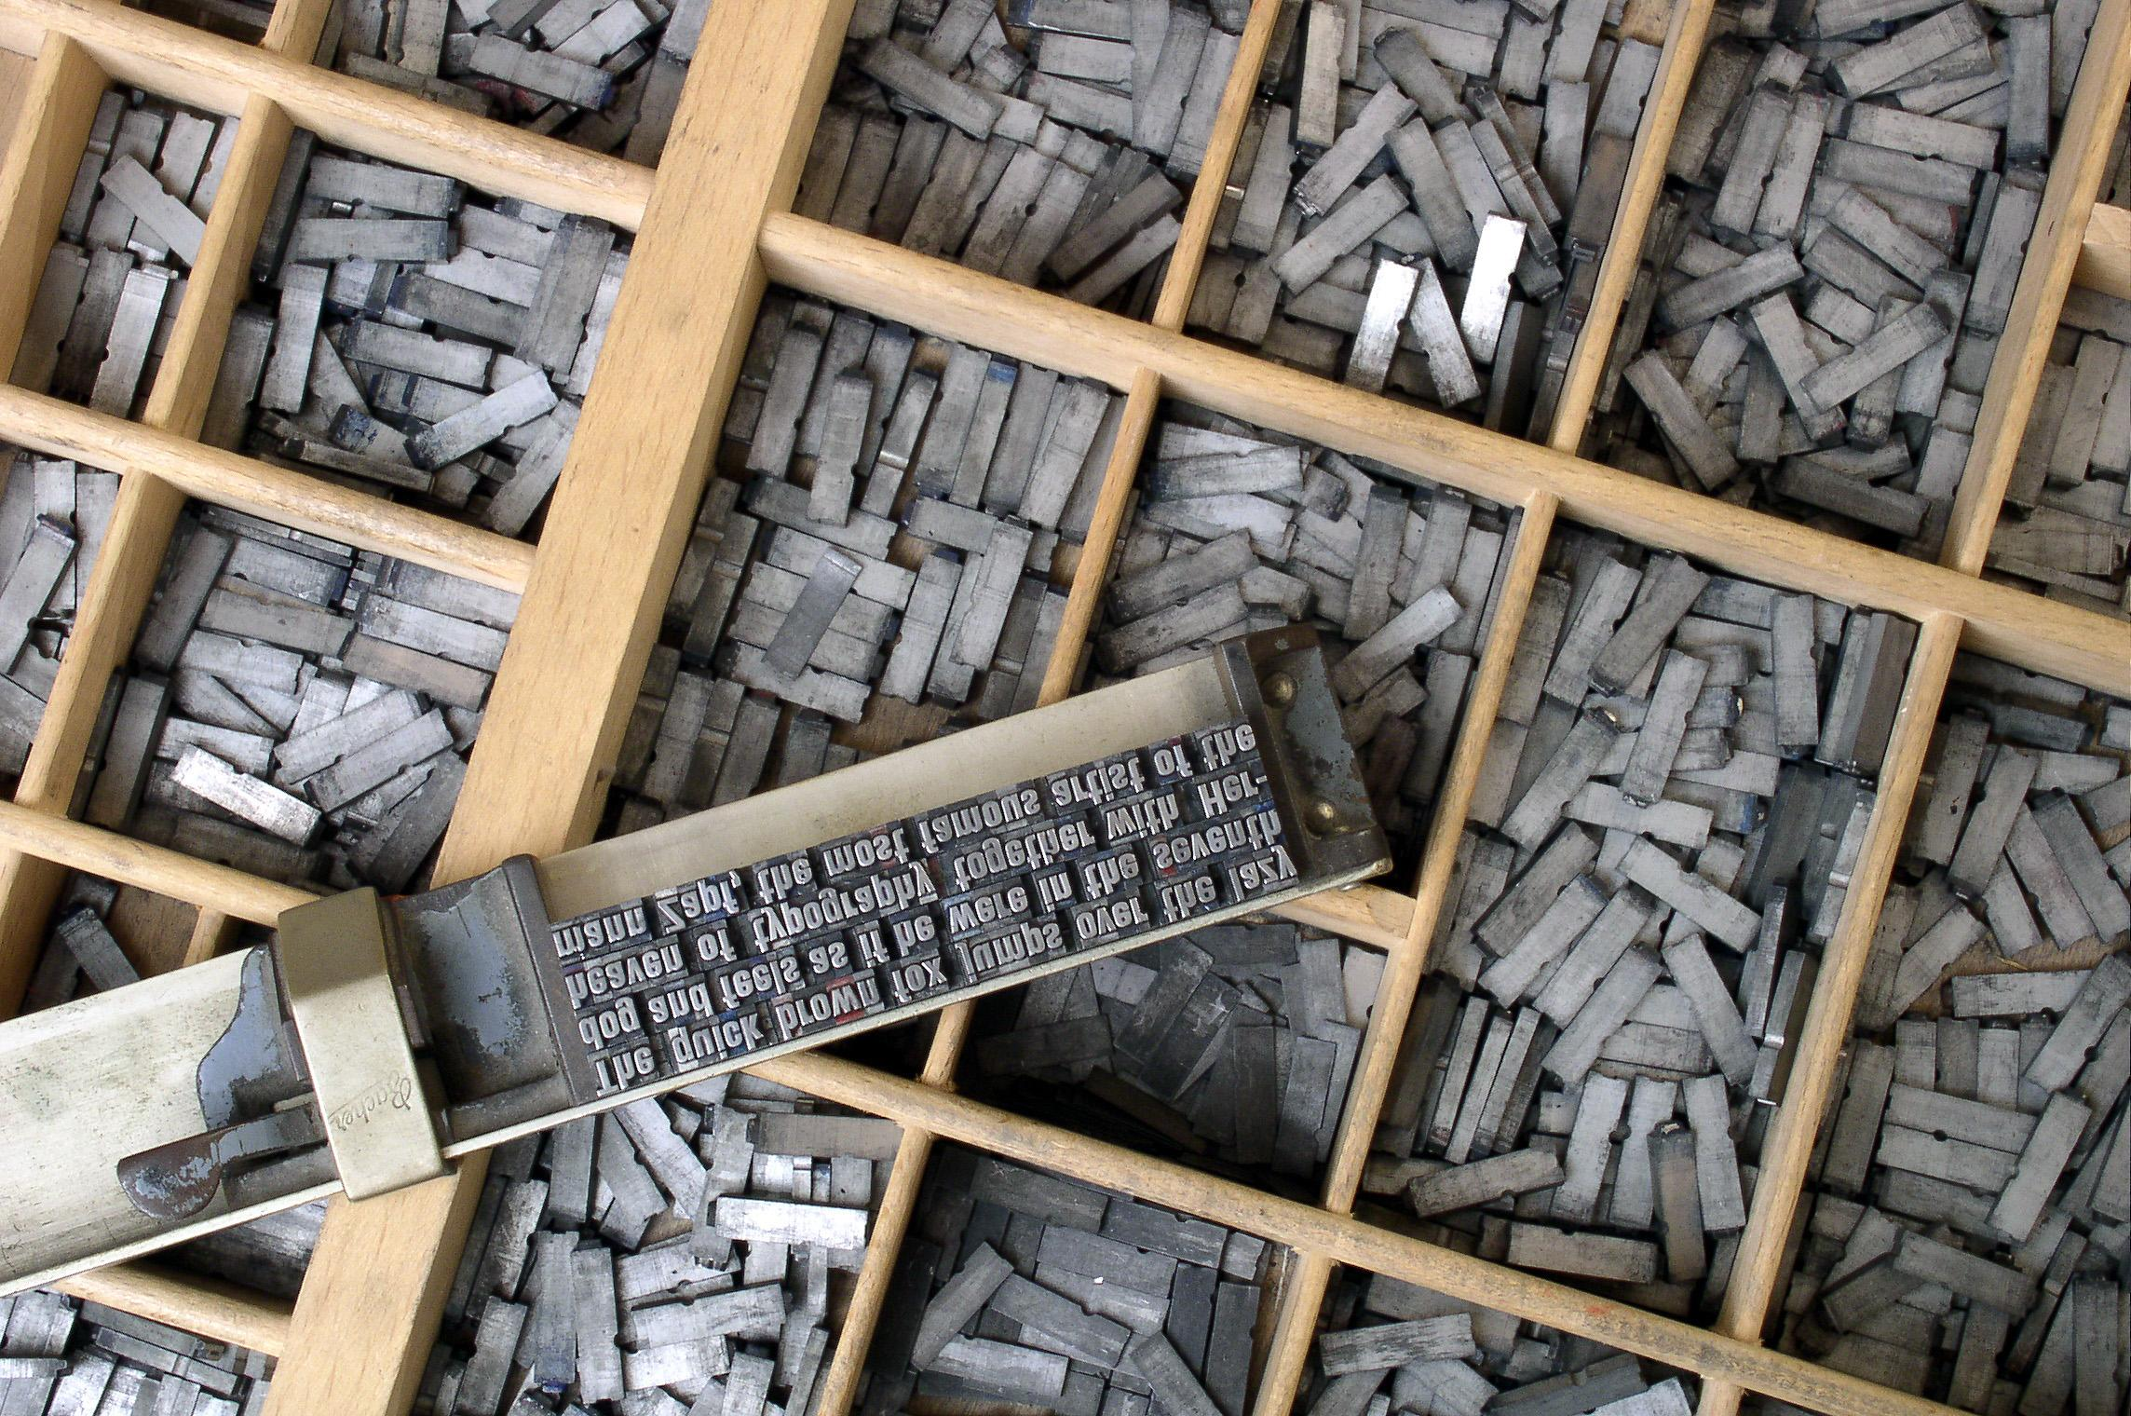
Cleaning Tasks
You may need to do one or more of the following tasks:
strip punctuation
change to lower case
remove stop words
tokenize
stem
lemmatize
subset
Notes:
Getting data from its raw form, often unstructured, often messy, to the place where we can begin analyzing it often requires a processing step. With text data, this can be stripping data of its punctuation, trimming white space, tokenization, and removing stop words. We might also have to take text data and turn it into a tablular data structure

Slide 33
Data cleaning terms
stopwords - [the, a, an, and, not, for, but, so…]
tokenize - the/cat/sat/on/the/mat/
stem - playing, played, player → play*
lemmatize -- good, better, best → good
trying, tried, tries → try
Notes:
stopwords: Common words like articles (a, an, the), prepositions (in, on, at, ...) etc. that don't carry specific meaning and that appear in text so frequently that they would throw off word frequency counts and other techniques. Stopwords are usually removed from texts before any further processing is done. Text analysis libraries usually come with pre-defined lists of stopwords and you can also define your own.
tokenizing:Tokenizing means breaking up a string into tokens, i.e., smaller units that can be used in the analysis process. For example, a text can be broken up into paragraphs, sentences, or individual words
stem: In many languages, words can have inflected forms, i.e., variations to express a different grammatical function, tense, mood, person, etc.: dog <- dog, dogs, dog's, dogs'; Stemming attempts to reduce similar words to a common stem by removing elements from the end of the word.
lemmatize: sort words by grouping inflected or variant forms of the same word.

Slide 34
Alternate approach:
Structuring text in a dataframe
(as opposed to a corpus)
Notes:
In this short course, we’re going to use multiple R packages, mostly for data analysis. I’m going to go over the most popular packages for working with data, and this includes both text, or qualitative data and numeric data.

Slide 35
Tidy the Data
Put unstructured text in a tabular structure
Take the text and turn it into a data frame with columns and rows
Use tidy data principles
Notes:
Getting data from its raw form, often unstructured, often messy, to the place where we can begin analyzing it often requires a processing step. With text data, this can be stripping data of its punctuation, trimming white space, tokenization, and removing stop words. We might also have to take text data and turn it into a tablular data structure

Slide 36
Tidy data principles
One variable per column
One observation per row
One value per cell
Lat, Long | Address
35.7796, -78.6382 | 3100 Hillsborough Street, Raleigh, NC
Lat | Long | Street | City | State
35.7796 | -78.6382 | 3100 Hillsborough Street | Raleigh | NC

Slide 37
Tidy text structure
“a table with one token per row” - Julia Silge, Text Mining with R
A token is a meaningful unit, such as a word, word pair, or sentence

Slide 38
Converting a text file to tidy text data frame

Slide 39

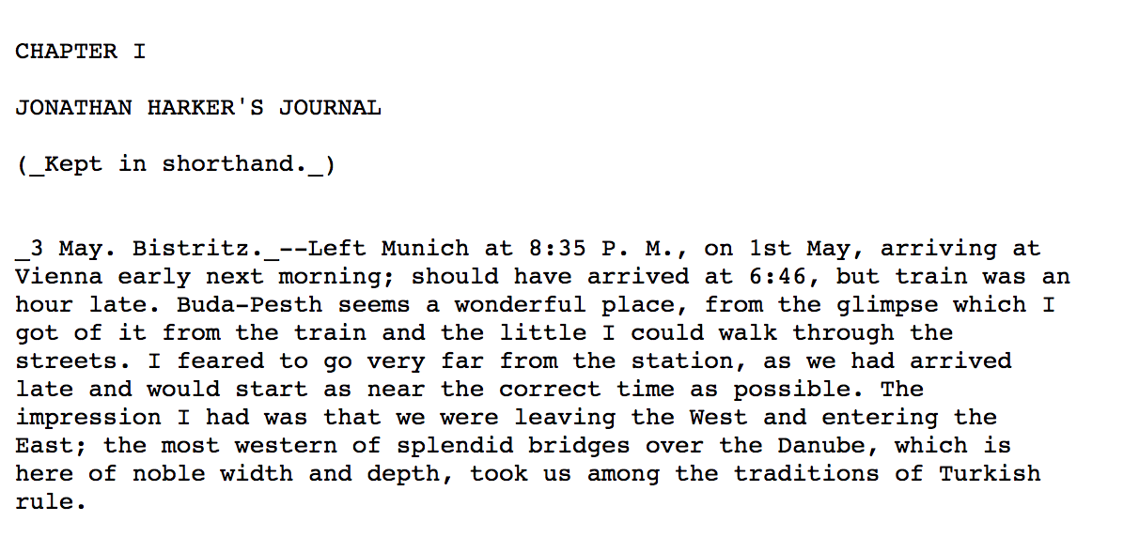
Raw text file

Slide 40
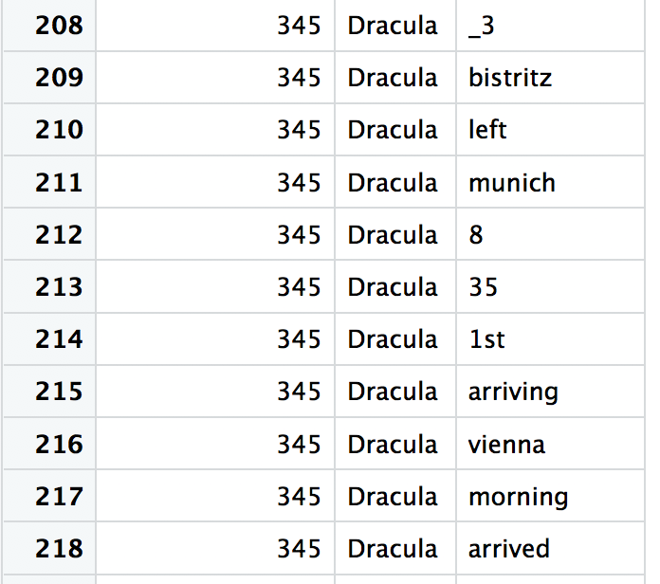
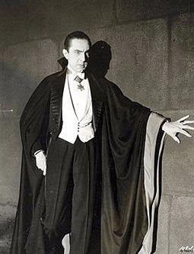
Tidy text
gutenberg_id
title
word

Slide 41
Text Analysis Methods
Notes:
Markus 42 through the end

Slide 42
Word frequency
Discover the most frequent words in a text
The mouse ate the cheese.
The 2
mouse 1
ate 1
cheese 1
Notes:
Word frequency - counts of how often a word appears in the text
Collocation - collocation is a sequence of words or terms that co-occur more often than would be expected by chance.
Concordance - words in the corpus along with their immediatelinguistic contexts and some information about the frequency and location of each.
N-grams (bi, tri-, etc) - a contiguous sequence of n items from a given sequence of text or speech.

Slide 43
Collocation
Conventional expressions of two or more words. Reveal patterns of word usage.
“time”
save time
make some time
nick of time
bide my time
Notes:
The words may or may not be next to each other

Slide 44
N-grams (bi, tri-, etc)
Example: “The merry month of May”
Where n = 2:
The merry
merry month
month of
of May
These are bigrams!
Notes:
Word pairs or multi-word groupings that occur next to each other. Like collocation, but the words must be next to each other.

Slide 45
Concordance
key word in context
‘Will you be my own true love?’ the musician sang...”
“took the dusty books with love and dusted them...”

Slide 46
Natural Language Processing
Part of speech tagging
Topic modeling
Sentiment analysis
Notes:
NLP - branch of artificial intelligence that helps computers understand, interpret and manipulate human language.(SAS website)
Part of speech tagging - the process of marking up a word in a text (corpus) as corresponding to a particular part of speech, based on both its definition and its context
Topic modeling - Topic model - statistical model for discovering the abstract "topics" that occur in a collection of documents
Sentiment analysis - the process of computationally identifying and categorizing opinions expressed in a piece of text, especially in order to determine whether the writer's attitude towards a particular topic, product, etc., is positive, negative, or neutral.

Slide 47
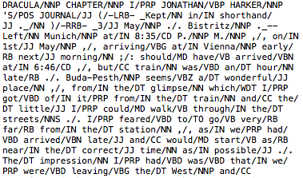
Part of speech tagging
Purpose: to be able to parse strings by part of speech
What are the most frequent nouns used in A Novel?
Notes:
Part of speech tagging - the process of marking up a word in a text (corpus) as corresponding to a particular part of speech, based on both its definition and its context
Topic modeling - Topic model - statistical model for discovering the abstract "topics" that occur in a collection of documents
Sentiment analysis - the process of computationally identifying and categorizing opinions expressed in a piece of text, especially in order to determine whether the writer's attitude towards a particular topic, product, etc., is positive, negative, or neutral.

Slide 48

Topic modeling
Purpose: discover “topics” in a collection of documents… using statistics!
Notes:
Part of speech tagging - the process of marking up a word in a text (corpus) as corresponding to a particular part of speech, based on both its definition and its context
Topic modeling - Topic model - statistical model for discovering the abstract "topics" that occur in a collection of documents
Sentiment analysis - the process of computationally identifying and categorizing opinions expressed in a piece of text, especially in order to determine whether the writer's attitude towards a particular topic, product, etc., is positive, negative, or neutral.

Slide 49
Topic modeling
You tell the computer to find 5 "topics" (gut feeling)
Computer tries to figure out 5 "topics" based on distribution of words -> doesn't know what those topics are about
Computer shows words that make up "topic"
You figure out connection between words
Notes:
Part of speech tagging - the process of marking up a word in a text (corpus) as corresponding to a particular part of speech, based on both its definition and its context
Topic modeling - Topic model - statistical model for discovering the abstract "topics" that occur in a collection of documents
Sentiment analysis - the process of computationally identifying and categorizing opinions expressed in a piece of text, especially in order to determine whether the writer's attitude towards a particular topic, product, etc., is positive, negative, or neutral.

Slide 50
Topic modeling with LDA
Latent Dirichlet Allocation Model
Uses probabilities to generate topics assumed hidden in a text
You give the computer X number of topics to discover.
The computer gives you X groups of words that statistically seem to have been generated by the hidden topics.
You don’t get the actual topics.
Notes:
Part of speech tagging - the process of marking up a word in a text (corpus) as corresponding to a particular part of speech, based on both its definition and its context
Topic modeling - Topic model - statistical model for discovering the abstract "topics" that occur in a collection of documents
Sentiment analysis - the process of computationally identifying and categorizing opinions expressed in a piece of text, especially in order to determine whether the writer's attitude towards a particular topic, product, etc., is positive, negative, or neutral.

Slide 51
You: Okay computer, find me 5 topics from this set of documents I have here. I don’t know what the topics are -- figure it out for me!
(you, the human, simply want to discover topics in a collection of documents. You pick the number 5 because it feels right)
LDA model example

Slide 52

Computer: OK. I assume that this text corpus is a random selection of words generated from exactly 5 topics. Let me figure out the five topics that generated this corpus.
(the computer model is not a human. It uses math to determine 5 original “topics” used to generate a text corpus, which it sees as a bag of words.)
WRDZ

Slide 53
Computer: here are the 5 topics and the words that have the highest probability of being associated with those topics:
Topic 1: house / horsemen / ride / night
Topic 2: window / bed / night / sleep
Topic 3: lantern / sea / mate / farthing
Topic 4: dogs / river / woods / darkness
Topic 5: shallow / november / hand / time
Human: Hmm...ok. Maybe topic one is “journey.” Maybe topic two is “home.” Maybe topic 3 is “seafaring.” Maybe topic 4 is “hunting.”

Slide 54
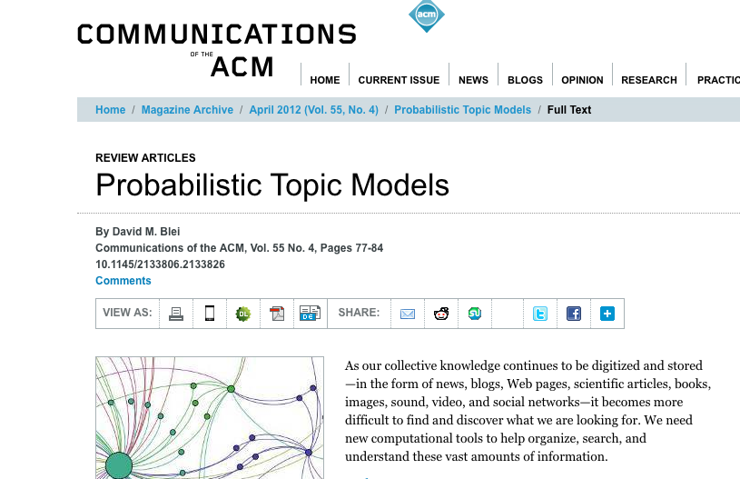
Topic models resource
Probabilistic Topic Models
By David M. Blei (2012)
Notes:
Part of speech tagging - the process of marking up a word in a text (corpus) as corresponding to a particular part of speech, based on both its definition and its context
Topic modeling - Topic model - statistical model for discovering the abstract "topics" that occur in a collection of documents
Sentiment analysis - the process of computationally identifying and categorizing opinions expressed in a piece of text, especially in order to determine whether the writer's attitude towards a particular topic, product, etc., is positive, negative, or neutral.

Slide 55
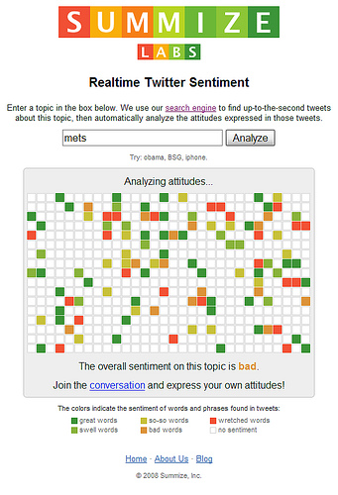
Sentiment analysis
Purpose: discover sentiment in a text (positive, negative, neutral, etc.)
Notes:
Part of speech tagging - the process of marking up a word in a text (corpus) as corresponding to a particular part of speech, based on both its definition and its context
Topic modeling - Topic model - statistical model for discovering the abstract "topics" that occur in a collection of documents
Sentiment analysis - the process of computationally identifying and categorizing opinions expressed in a piece of text, especially in order to determine whether the writer's attitude towards a particular topic, product, etc., is positive, negative, or neutral.

Slide 56
Sentiment analysis
I don’t like seagulls. They creep me out.
I don’t dislike seagulls. Some think they are creepy but I don’t.

Slide 57
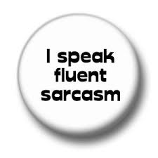

Sentiment analysis
Limited:
Sentiment is objective
Sentiment is not always expressed explicitly
Words can have multiple meanings

Slide 58
Text Analysis: Glossary
tf-idf - how important a term is in distinguishing a text from others in a collection
document-term matrix - matrix of whether a term exists in a document. rows: documents, columns: terms
Notes:
Tf-idf - term frequency–inverse document frequency, is a numerical statistic that is intended to reflect how important a word is to a document in a collection or corpus.
Document-term matrix - a mathematical matrix that describes the frequency of terms that occur in a collection of documents. In a document-term matrix, rows correspond to documents in the collection and columns correspond to terms.
Bigrams - A bigram or digram is a sequence of two adjacent elements from a string of tokens, which are typically letters, syllables, or words

Slide 59
Workshop activities
Data import & cleaning
word frequency
tf-idf
also in the script but not covered:
topic modeling with LDA model
sentiment analysis

Slide 60
Resources
Julia Silge and David Robinson (2017), Text Mining with R: A Tidy Approach
Matthew Jockers (2014), Text Analysis with R for Students of Literature

Slide 61
go.ncsu.edu/libeval
Evaluation

Slide 62

Another
Relaxing
Dog
Picture

